Slide 1


AUTOMECHANIKA INDIA
www.techsciresearch.com
MARKET INTELLIGENCE. CONSULTING

Slide 2
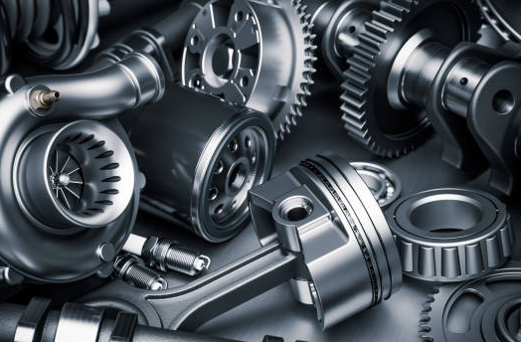
FY 2022
INDIA AUTOMOTIVE AFTERMARKET
www.techsciresearch.com
MARKET INTELLIGENCE. CONSULTING

Slide 3
India Automotive Aftermarket Share, By Part Type
India Automotive Aftermarket Share, By Part Type, By Value, FY2022
Other Includes:*Steering system hard parts, Remanufactured engine and transmission, remanufactured rack and pinion steering gear, Heating Ventilation and Air Conditioning (HVAC), light vehicle exhaust emission control systems, fuel-delivery systems, engine control units, ignition parts, automotive sensors, ignition wire sets, fuel pumps, selected automotive remanufactured pumps, sports compact underhood components, belt, hoses, gaskets and seals, carburetor, gauge, and internal engine hard parts
Source: TechSci Research
Overall Aftermarket Value | USD 13.41 Billion

Slide 4
India Automotive Aftermarket Share, By Trade
India Automotive Aftermarket Share, By Trade, By Value, FY2022
Source: TechSci Research
India’s Automotive aftermarket was valued at USD 13.41 billion in FY 2022, including about USD 4.2 billion in imports.

Slide 5
India Automotive Aftermarket Share, By Percentage Of Imports By Product Segmentation, By Value
India Automotive Aftermarket Share, By Percentage Of Imports By Product Segmentation, By Value, FY2022
Other Includes:*Ignition Parts, Brake Parts, Remanufactured engine and transmission, remanufactured rack and pinion steering gear, Heating Ventilation and Air Conditioning (HVAC), light vehicle exhaust emission control systems, fuel-delivery systems, ignition parts, automotive sensors, ignition wire sets, fuel pumps, selected automotive remanufactured pumps, sports compact underhood components, belt, hoses, gaskets and seals, carburetor, gauge, and internal engine hard parts etc.
Source: TechSci Research
India's automotive aftermarket share by product import is led by the tire industry, with others capturing the bulk of shares due to a diverse product portfolio.
Source: TechSci Research

Slide 6
India Automotive Aftermarket Share, By Percentage of Imports By Country, By Value
India Automotive Aftermarket Share, By Percentage of Imports By Country, By Value, FY2022
Other Includes:*Belgium, Australia, UAE, Philippines, Brazil, Italy, Romania, Sweden, Indonesia, Hong Kong, Taiwan, Slovenia, Hungary etc.
Source: TechSci Research

Slide 7
India Automotive Aftermarket Size, By Value
India Automotive Aftermarket Size, By Value (USD Billion), FY2022-FY2028F
Source: TechSci Research
India's automotive aftermarket was valued at USD 13.41 billion in 2022 and is expected to reach USD 21.36 billion by 2028 growing at a CAGR of 8.07% in upcoming years. The average age of automobiles is continuously increasing as technology progresses and vehicles become more resilient. Furthermore, some of the major reasons for this include development of an organized used car market, higher vehicle build quality and OE standards, increased emphasis and awareness on car maintenance, and a lack of strict regulations for automobile lifespans in India. These factors are anticipated to drive the demand for automotive aftermarket in the coming years.

Slide 8
India Automotive Aftermarket Sales Figures, By Value (USD Million)
India Automotive Aftermarket Sales Figures of Top Domestic Companies, By Value, FY2022
Company | Sales (USD Million)
Madras Rubber Factory limited | 769.05
Apollo Tyres Limited | 540.80
Motherson Sumi Systems Ltd | 217.35
Exide Industries Limited | 200.47
Minda Industries Ltd | 111.51
Varroc Engineering | 67.06
Endurance Technologies Ltd | 56.86
Lumax Industries Limited | 28.37
Munjal Showa Ltd | 27.19
Automotive Axles Ltd | 20.12
Source: TechSci Research

Slide 9
India Automotive Aftermarket Sales Figures, By Value (USD Million)
India Automotive Aftermarket Sales Figures of Top International Companies, By Value, FY2022
Company | Sales (USD Million)
Continental AG | 280.89
Castrol Limited | 254.66
Robert Bosch GmbH | 192.21
ZF Friedrichshafen AG | 110.55
Magneti Marelli S.p.A. | 97.00
DENSO Corporation | 42.30
Bridgestone Corporation | 37.19
Goodyear Tire and Rubber Company | 28.95
Valeo S.A. | 27.35
Hella KGaA Hueck & Co. | 13.72
Source: TechSci Research

Slide 10

MARKET DYNAMICS

Slide 11
Market Drivers
Focus on Reduced Emissions/Exhaust & Improved Fuel Consumption Technology by Component Manufacturers
The need for more fuel-efficient, automobiles has increased the demand for aftermarket components like electronic chips and catalytic converters. Owners' keen interest in upgrading their older vehicles with new features is a major factor in the expansion of the automotive aftermarket sector.
Original equipment manufacturers have continuously increased their level of engagement and attention within the automotive parts aftermarket value chain, OEMs have started distributing their parts directly to stores in order to improve customer engagement, cut down on counterfeit goods, and keep their brands at the forefront of the market. By utilizing vehicle connection, for example, to keep customers and automate service and repair decision-making, OEMs are also investing in customer experience optimization initiatives and developing differentiated aftermarket service options.
The aftermarket service is used to upgrade the existing automobiles with new parts or to repair a damaged item in a vehicle. Various parts of the clients' automobiles such as tires, batteries, oils and fluids need to be changed at predetermined intervals. For example, depending on driving conditions, passenger automobiles need to replace their tires every 3–4 years. Consequently, there is a sizable aftermarket for vehicle parts. Additionally, the aftermarket is expanding as a result of consumer preferences for installing cutting-edge automotive components to enhance vehicle look and ensure driver safety.
1
2
Direct reach by OEMs to Retailers
3
Replacement sales Growth Rate

Slide 12
Market Challenges
The phrase "counterfeit components" describes replicas of parts from well-known brands. The vendors don't follow the standards or employ a uniform testing technique, even though that the parts are supplied in the unorganized sector under brand names. This creates a big barrier in the Indian aftermarket. A few manufacturers have developed parts with holographic sealing in response to the problem of counterfeit components.
The highly distributed Indian service network ecology is dominated by independent workshops. The IAM is facing a variety of difficulties, such as developing the necessary infrastructure, enhancing skill sets to accommodate contemporary technologies, and gaining technical expertise, which contains concerns about the caliber of services. There is also lack in availability of parts of old vehicle models due to lack of supply chain also with increasingly modern cars, this issue will result in more OES channel alternatives.
The rise in pricing issues is occurring more frequently as new players (Tier 1 and Tier 2 companies) enter the market and keep component prices much lower than Tier 1 companies. As a result, Tier 1 players are finding it extremely challenging to meet their sales goals and are primarily focused on supplying OEMs. Customers in India prioritise cost above quality, thus they choose to purchase counterfeit parts over high-quality products. Owing to these reasons, the aftermarket is anticipated to face some fascinating effects of this shift in the automotive industry.
Pe
Lacking Substantial Product Availability on Regular Basis
Aftermarket Counterfeit Parts and the Unorganized Sector
Competitive Pricing Issue

Slide 13

MARKET TRENDS AND DEVELOPMENTS

Slide 14
Market Trends and Developments
Improvising in Product development Capabilities
To meet the quality product standard, companies are expanding their spending in establishing up R&D operations and laboratories to execute tasks like analysis, simulation, and engineering animations. Additionally, the expansion of global OEM sourcing from India over the past several years and the increasing indigenization of global OEMs are making the nation a desirable location for designing and manufacturing. Nitin Gadkari, Minister of Road Transport and Highways, requested that flex-fuel vehicle production begin within the next six months in December 2021. ZF, a prominent manufacturer of German automotive components, opened and extended its new Tech centre in India in June 2022.In March 2022, Minister of State for Power and Heavy Industries Mr. Krishan Pal Gurjar, said that Indian and foreign automobile manufacturers have taken initiatives to develop hydrogen fuel cell vehicles.
1
Growing Popularity of E-commerce Platform
The lack of domestically produced items, low prices, market participants' consumer-focused targeting, and higher-quality goods have all contributed to the expansion of the e-commerce sector. Additionally, e-commerce enables OEMs with a chance to sell their goods directly to customers, relieving them of the troublesome supply chain, and provides SMEs with numerous benefits for business growth and globalization. Global utilization of the e-commerce logistics sector will increase as the rising country's index of digital service acceptance rises. An international indicator called the "Digital Service Adoption Index" tracks how many sectors of society—including business, government, and the general public—have adopted digital technology. Organizations can thrive in a world where technology is widely used thanks to the efficiency and connectivity that digital technologies offer.
2
Rise in Investment
Alliance Tire Group (ATG), a manufacturer of off-highway tires owned by the Yokohama Group of Japan, revealed intentions to construct its third facility in the nation in Visakhapatnam in September 2020. The project is expected to cost USD 165 Million (Rs. 1,240 crore). According to Mr. Soumitra Bhattacharya, managing director of Bosch Ltd, the manufacturer of auto components, plans to invest more than USD 25.12 million Rs. 200 crore in India over the next five years in the fields of advanced automotive technologies and digital mobility. Also, German Auto component major ZF has doubled down on India with an investment of USD 214.10 Billion.
3

Slide 15
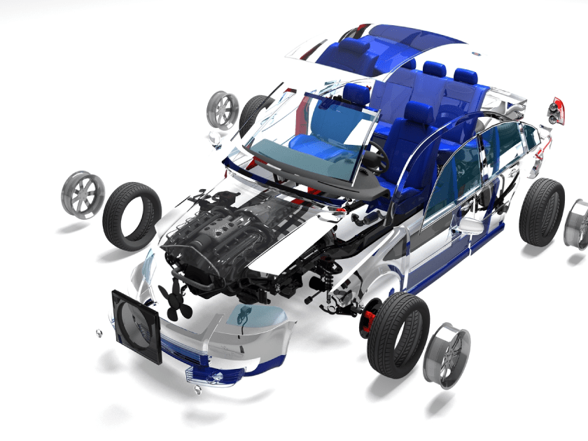
PRODUCT BENCHMARKING

Slide 16
Product Benchmarking
Key Products Import Analysis:
Product | Reporting Country | Prominent Importing Country
Brakes | India | Germany, China, South Korea, United States, Italy
Tires | India | Thailand, China, Indonesia, Malaysia, Vietnam, Japan
Oils and Fluids | India | United States, Singapore, China, Germany, France
Batteries | India | China, Thailand., Sweden, Vietnam, United States, Japan
Filter | India | Japan, China, France, South Korea, Singapore, Germany
Starter/Alternators | India | China, Indonesia, Japan, South Korea, Thailand, Germany
Spark Plugs | India | China, Thailand, Japan, Vietnam, South Korea
Lighting | India | China, South Korea, Japan, Germany, Phillipines
Source: TechSci Research

Slide 17

About Us & Disclaimer
TechSci Research is a global market research and consulting company with offices in the US, UK and India. TechSci Research provides market research reports in number of areas to organizations. The company uses innovative business models that focus on improving productivity, while ensuring creation of high-quality reports. The proprietary forecasting models use various analyses of both industry-specific and macroeconomic variables on a state-by-state basis to produce a unique ‘bottom-up’ model of a country, regional and global industry prospects. Combined with the detailed analysis of company activity and industry trends, the result is a uniquely rich evaluation of the opportunities available in the market.
Related Reports
Tire Market - Global Industry Size, Share, Trends, Competition, Opportunity and Forecast, 2017-2027F, Segmented By Vehicle Type (Passenger Car Light Commercial Vehicle, Medium & Heavy Commercial Vehicle, Two Wheelers, Three Wheelers and OTR), By Demand Category (OEM and Replacement), By Tire Construction Type (Radial and Bias), By Region
Automotive Filter Market - Global Industry Size, Share, Trends, Competition, Opportunity, and Forecast, 2017-2027, Segmented By Vehicle Type (Passenger Cars, Light Commercial Vehicles, Medium & Heavy Commercial Vehicles, Two-Wheeler, Off-the-Road Vehicles), By Filter Type (Air Filter, Oil Filter & Fuel Filter), By Applications (Cabin filter, Engine Filter), By Filter Media (Particulate, Activated Carbon Media, Cellulose Media, Synthetic Media, Others), By Demand Category (OEM, Replacement), By Region
TechSci Research – North America
708 Third Avenue, Manhattan,
New York, United States
Tel: +1- 646- 360- 1656
Email: sales@techsciresearch.com www.techsciresearch.com
TechSci Research – Europe
54, Old brook, Bretton,
Peterborough,
United Kingdom
Email: sales@techsciresearch.com www.techsciresearch.com
TechSci Research – Asia-Pacific
B – 44, Sector – 57, Noida, National Capital Region, U.P. - India
Tel: +91-120-4523900
Email: sales@techsciresearch.com www.techsciresearch.com
Disclaimer
The contents of this report are based on information generally available to the public from sources believed to be reliable. No representation is made that it is timely, accurate or complete. TechSci Research has taken due care and caution in compilation of data as this has been obtained from various sources including which it considers reliable and firsthand. However, TechSci Research does not guarantee the accuracy, adequacy or completeness of any information and it is not responsible for any errors or omissions or for the results obtained from the use of such information and especially states that it has no financial liability whatsoever to the subscribers / users of this report. The information herein, together with all estimates and forecasts, can change without notice. All the figures provided in this document are indicative of relative market size and are strictly for client’s internal consumption. Usage of the same for purpose other than internal will require prior approval of TechSci Research.

